Slide 1

OPERATING SYSTEMS
DEADLOCKS
Class Presentations on Operating System
by Subhash Chand Agrawal

Slide 2
Resources
A resource used by process can be a piece of hardware such as
  Memory
  CPU cycle
  Printer
  CD ROM
  or a piece of information such as
  a file
  a record within a file
  a shared variable
  a critical section
  etc.

Slide 3
Types of Resources
Resources come in two flavors: preemptable and nonpreemptable.
A preemptable resource is one which can be allocated to a given process for a period of time, then be allocated to another process and then be reallocated to the first process without any ill effects.
Examples of preemptable resources include:
  memory
  buffers
  CPU
  etc.

Slide 4
A nonpreemptable resource cannot be taken from one process and given to another without side effects.
One obvious example is a printer: certainly we would not want to take the printer away from one process and give it to another in the middle of a print job

Slide 5
DEADLOCKS
EXAMPLES:
You can't get a job without experience; you can't get experience without a job.
BACKGROUND:
Each resource type R_{i} has W_{i} instances.
Under normal operation, a resource allocations proceed like this:
  Request a resource (suspend until available if necessary ).
  Use the resource.
  Release the resource.

Slide 6
Bridge Crossing Example
DEADLOCKS
Traffic only in one direction.
Each section of a bridge can be viewed as a resource.
If a deadlock occurs, it can be resolved if one car backs up (preempt resources and rollback).
Several cars may have to be backed up if a deadlock occurs.
Starvation is possible.

Slide 7
Q1.
A single-lane bridge connects the two villages X and Y. Farmers in the two villages use this bridge to deliver their produce to the neighboring town. The bridge can become deadlocked if both a X and a Y farmer get on the bridge at the same time. Using exactly one semaphore, design an algorithm that prevents deadlock. Do not be concerned about starvation and inefficiency.

Slide 8
Solution
semaphore ok_to_cross = 1;
void enter_bridge()
{
P(ok_to_cross);
}
void exit_bridge()
{
V(ok_ to_cross);
}

Slide 9
DEADLOCK CHARACTERISATION
NECESSARY CONDITIONS
ALL of these four must happen simultaneously for a deadlock to occur:
Mutual exclusion
At least one resource must be held in a non sharable mode.
only one process at a time can use a resource.
Hold and Wait
A process holds a resource while waiting for another resource, currently held by another process.
7: Deadlocks

Slide 10
DEADLOCK CHARACTERISATION
No Preemption
a resource can be released only voluntarily by the process holding it, after that process has completed its task.
Circular Wait
There exists a set {P₀, P₁, …, P_{n}} of waiting processes such that P₀ is waiting for a resource that is held by P₁, P₁ is waiting for a resource that is held by P₂, …, P_{n–1} is waiting for a resource that is held by P_{n}, and P_{n} is waiting for a resource that is held by P₀.

Slide 11
RESOURCE ALLOCATION GRAPH
A visual ( mathematical ) way to determine if a deadlock has, or may occur.
G = ( V, E ) The graph contains nodes and edges.
V is partitioned into two types:
  P = {P₁, P₂, …, P_{n}}, the set consisting of all the processes in the system
  R = {R₁, R₂, …, R_{m}}, the set consisting of all resource types in the system

Slide 12
RESOURCE ALLOCATION GRAPH
E request edge – directed edge P_{i} → R_{j}
  assignment edge – directed edge R_{j} → P_{i}
An arrow from the process to resource indicates the process is requesting the resource.
An arrow from resource to process shows an instance of the resource has been allocated to the process.
Process is a circle,
resource type is square;
dots represent number of instances of resource in type.
Request points to square, assignment comes from dot.

Slide 13


Resource-Allocation Graph (Cont.)
Process
Resource Type with 4 instances
P_{i} requests instance of R_{j}
P_{i} is holding an instance of R_{j}
P_{i}
R_{j}
P_{i}
R_{j}

Slide 14

RESOURCE ALLOCATION GRAPH
R3 Assigned to P3
Resource allocation graph
P2 Requests P3

Slide 15
RESOURCE ALLOCATION GRAPH
If the graph contains no cycles, then no process is deadlocked.
If there is a cycle, then:
  a) If resource types have multiple instances, then deadlock MAY exist.
  b) If each resource type has 1 instance, then deadlock has occurred.

Slide 16

RESOURCE ALLOCATION GRAPH
Resource allocation graph
with a deadlock.

Slide 17

RESOURCE ALLOCATION GRAPH
Resource allocation graph with a cycle but no deadlock.

Slide 18
Strategy
HOW TO HANDLE DEADLOCKS – GENERAL STRATEGIES
There are three methods:
Ignore Deadlocks pretend that deadlocks never occur in the system :
Ensure deadlock never occurs using either
  Prevention Prevent any one of the 4 conditions from happening.
  Avoidance Allow all deadlock conditions, but calculate cycles about to happen and stop dangerous operations..
Most Operating systems do this!!

Slide 19
Strategy
HOW TO HANDLE DEADLOCKS – GENERAL STRATEGIES
Allow deadlock to happen. This requires using both:
  Detection Know a deadlock has occurred.
  Recovery Regain the resources.

Slide 20
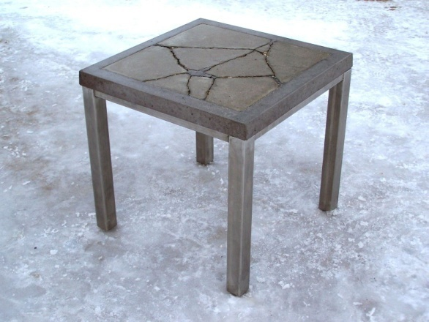
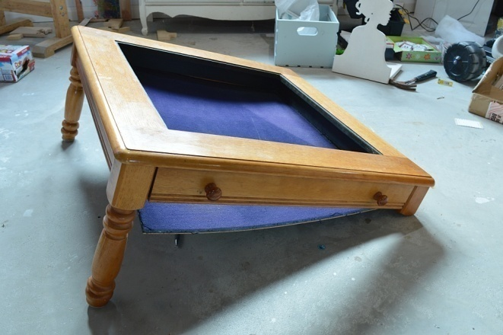
Deadlock
Prevention
Do not allow one of the four conditions to occur.
  a) Shared entities (read only files) don't need mutual exclusion (and aren’t susceptible to deadlock.)
  (b) Prevention not possible, since some devices are intrinsically non-sharable.
  (c) We cannot force a resource to be used by more than one process at the same time since it will not be fair enough and some serious problems may arise in the performance.

Slide 21
Deadlock
Prevention
Do not allow one of the four conditions to occur.
Hold and wait:
!(Hold and wait) = !hold or !wait
  a) Collect all resources before execution.
  b) A particular resource can only be requested when no others are being held.
  Utilization is low, starvation possible.
  (Possibility of getting starved will be increases due to the fact that some process may hold a resource for a very long time.)

Slide 22
Deadlock
Prevention
No preemption:
  Deadlock arises due to the fact that a process can't be stopped once it starts.
  However, if we take the resource away from the process which is causing deadlock then we can prevent deadlock.
  (Consider a printer is being used by any process. If we take the printer away from that process and assign it to some other process then all the data which has been printed can become inconsistent and ineffective and also the fact that the process can't start printing again from where it has left which causes performance inefficiency.)

Slide 23
Deadlock
Prevention
Circular wait:
  impose a total ordering of all resource types, and require that each process requests resources in an increasing order of enumeration
  Tape drive, disk drive, printers
  F(Tape drive)=1
  F(disk drive)=5
  F(printer)=12
  F:R
  N
  F(Rj)>F(Ri)

Slide 24
Deadlock
Avoidance
If we have prior knowledge of how resources will be requested, it's possible to determine if we are entering an "unsafe" state.
Possible states are:
  Deadlock No forward progress can be made.
  Unsafe state A state that may allow deadlock.

Slide 25
Deadlock
Avoidance
  Safe state A state is safe if a sequence of processes exist such that there are enough resources for the first to finish, and as each finishes and releases its resources there are enough for the next to finish.
The rule is simple: If a request allocation would cause an unsafe state, do not honor that request.

Slide 26
Deadlock
Avoidance
NOTE: All deadlocks are unsafe, but all unsafes are NOT deadlocks.
SAFE
UNSAFE
DEADLOCK
Only with luck will processes avoid deadlock.
O.S. can avoid
deadlock.

Slide 27
Deadlock
Avoidance
Let's assume a very simple model: each process declares its maximum needs. In this case, algorithms exist that will ensure that no unsafe state is reached.
EXAMPLE:
There exists a total of 12 tape drives. The current state looks like this:
There are multiple instances of the resource in these examples.
<Available=3>
In this example, < p1, p0, p2 > is a workable sequence.
if process P2 requests and is granted one more tape drive?What happens then?
Process | Max Needs | Allocated
P0 | 10 | 5
P1 | 4 | 2
P2 | 9 | 2
Current Needs
5
2
7

Slide 28
Resource-Allocation Graph Scheme
Claim edge P_{i} → R_{j} indicated that process P_{i} may request resource R_{j}; represented by a dashed line
Claim edge converts to request edge when a process requests a resource
Request edge converted to an assignment edge when the resource is allocated to the process
When a resource is released by a process, assignment edge reconverts to a claim edge
Resources must be claimed a priori in the system

Slide 29

Resource-Allocation Graph

Slide 30

Unsafe State In Resource-Allocation Graph

Slide 31
Resource-Allocation Graph Algorithm
Suppose that process P_{i} requests a resource R_{j}
The request can be granted only if converting the request edge to an assignment edge does not result in the formation of a cycle in the resource allocation graph

Slide 32
Deadlock
Avoidance
Safety Algorithm
A method used to determine if a particular state is safe.
It's safe if there exists a sequence of processes such that for all the processes, there’s a way to avoid deadlock:
The algorithm uses these variables:
  Need[I] – the remaining resource needs of each process.
  Work - Temporary variable – how many of the resource are currently available.

Slide 33
Deadlock
Avoidance
Safety Algorithm
  Finish[I] – flag for each process showing we’ve analyzed that process or not.
Let work and finish be vectors of length m and n respectively.
Now tell, What is the size of array or matrix?
Available?
Max need?
Allocation?
Need?

Slide 34
Deadlock
Avoidance
Safety Algorithm
1. Initialize work = available
Initialize finish[i] = false, for i = 0,1,2,3,..n-1
2. Find an i such that:
finish[i] == false and need[i] <= work
If no such i exists, go to step 4.
3. work = work + allocation[i]
finish[i] = true
goto step 2
4. if finish[i] == true for all i, then the system is in a safe state.

Slide 35
Deadlock
Avoidance
Safety Algorithm
Consider a system with: five processes, P0 → P4, three resource types, A, B, C. Type A has 10 instances, B has 5 instances, C has 7 instances. At time T0 the following snapshot of the system is taken.
Max Needs = allocated + can-be-requested
Max
A | B | C
7 | 5 | 3
3 | 2 | 2
9 | 0 | 2
2 | 2 | 2
4 | 3 | 3
Allocation
A | B | C
0 | 1 | 0
2 | 0 | 0
3 | 0 | 2
2 | 1 | 1
0 | 0 | 2
Need
A | B | C
7 | 4 | 3
1 | 2 | 2
6 | 0 | 0
0 | 1 | 1
4 | 3 | 1
Available
A | B | C
3 | 3 | 2
P0
P1
P2
P3
P4
Is the system
in a safe state?
<P1, P3, P4, P2, P0>

Slide 36
Deadlock
Avoidance
Safety Algorithm
P1 requests one additional resource of type A, and two more of type C.
Request1 = (1,0,2).
Is Request1 < available?
Max
A | B | C
7 | 5 | 3
3 | 2 | 2
9 | 0 | 2
2 | 2 | 2
4 | 3 | 3
Allocation
A | B | C
0 | 1 | 0
3 | 0 | 2
3 | 0 | 2
2 | 1 | 1
0 | 0 | 2
Need
A | B | C
7 | 4 | 3
0 | 2 | 0
6 | 0 | 0
0 | 1 | 1
4 | 3 | 1
Available
A | B | C
2 | 3 | 0
P0
P1
P2
P3
P4
<P1, P3, P4,P0,P2>
Produce the state chart as if the request is Granted and see if it’s safe.

Slide 37
Deadlock
Avoidance
Do these examples:
P4 request additional (3,3,0)
Can the request be granted?
Request can not be granted since the resources are not available
 | ← | Alloc | → |  | ← | Need | → |  | ← | Avail | →
 | A | B | C |  | A | B | C |  | A | B | C
P0 | 0 | 1 | 0 |  | 7 | 4 | 3 |  | 2 | 3 | 0
P1 | 3 | 0 | 2 |  | 0 | 2 | 0
P2 | 3 | 0 | 2 |  | 6 | 0 | 0
P3 | 2 | 1 | 1 |  | 0 | 1 | 1
P4 | 0 | 0 | 2 |  | 4 | 3 | 1

Slide 38
Deadlock
Avoidance
P0 request additional (0,2,0)
Can the request be granted?
 | ← | Alloc | → |  | ← | Need | → |  | ← | Avail | →
 | A | B | C |  | A | B | C |  | A | B | C
P0 | 0 | 3 | 0 |  | 7 | 2 | 3 |  | 2 | 1 | 0
P1 | 3 | 0 | 2 |  | 0 | 2 | 0
P2 | 3 | 0 | 2 |  | 6 | 0 | 0
P3 | 2 | 1 | 1 |  | 0 | 1 | 1
P4 | 0 | 0 | 2 |  | 4 | 3 | 1
Even resources are available, since the resulting state is unsafe

Slide 39

Deadlock Detection
Need an algorithm that determines if deadlock occurred.
Also need a means of recovering from that deadlock.
SINGLE INSTANCE OF A RESOURCE TYPE
Wait-for graph == remove the resources from the usual graph and collapse edges.
An edge from p(i) to p(j) implies that p(i) is waiting for p(j) to release.

Slide 40
Deadlock Detection
SEVERAL INSTANCES OF A RESOURCE TYPE
Complexity is of order m * n * n.
We need to keep track of:
available - records how many resources of each type are available.
allocation - number of resources of type m allocated to process n.
request - number of resources of type m requested by process n.
Let work and finish be vectors of length m and n respectively.

Slide 41
Deadlock Detection
1. Initialize work[] = available[]
For i = 1,2,...n, if allocation[i] != 0 then
finish[i] = false; otherwise, finish[i] = true;
2. Find an i such that:
finish[i] == false and request[i] <= work
If no such i exists, go to step 4.
3. work = work + allocation[i]
finish[i] = true
goto step 2
4. if finish[i] == false for some i, then the system is in deadlock state.
IF finish[i] == false, then process p[i] is deadlocked.

Slide 42
Deadlock Detection
EXAMPLE
We have three resources, A, B, and C. A has 7 instances, B has 2 instances, and C has 6 instances. At this time, the allocation, etc. looks like this:
Is there a sequence that will allow deadlock to be avoided?
Is there more than one sequence that will work?
←
Alloc
→
←
Req
→
←
Avail
→
A
B
C
A
B
C
A
B
C
P0
0
1
0
0
0
0
0
0
0
P1
2
0
0
2
0
2
P2
3
0
3
0
0
0
P3
2
1
1
1
0
0
P4
0
0
2
0
0
2

Slide 43
Deadlock Detection
EXAMPLE
Suppose the Request matrix is changed like this. In other words, the maximum amounts to be allocated are initially declared so that this request matrix results.
Is there now a sequence that will allow deadlock to be avoided?
USAGE OF THIS DETECTION ALGORITHM
Frequency of check depends on how often a deadlock occurs and how many processes will be affected.
←
Alloc
→
←
Req
→
←
Avail
→
A
B
C
A
B
C
A
B
C
P0
0
1
0
0
0
0
0
0
0
P1
2
0
0
2
0
2
P2
3
0
3
0
0
1#
P3
2
1
1
1
0
0
P4
0
0
2
0
0
2

Slide 44
Deadlock Recovery
So, the deadlock has occurred. Now, how do we get the resources back and gain forward progress?
PROCESS TERMINATION:
  Could delete all the processes in the deadlock -- this is expensive.
  Delete one at a time until deadlock is broken ( time consuming ).
  Select who to terminate based on priority, time executed, time to completion, needs for completion, or depth of rollback
  In general, it's easier to preempt the resource, than to terminate the process.

Slide 45
Deadlock Recovery
RESOURCE PREEMPTION:
  Select a victim - which process and which resource to preempt.
  Rollback to previously defined "safe" state.
  Prevent one process from always being the one preempted ( starvation ).

Slide 46
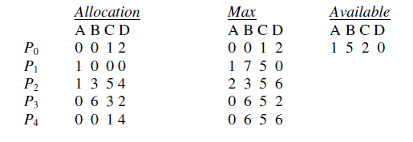
Q2.
Consider the following snapshot of a system:
Answer the following questions using the banker’s algorithm:
a. What is the content of the matrix Need?
b. Is the system in a safe state?
c. If a request from process P1 arrives for (0,4,2,0), can the request be granted immediately?

Slide 47
Solution
(a) The values of Need for processes P0 through P4 respectively are (0, 0, 0, 0), (0, 7, 5, 0), (1,0, 0, 2), (0, 0, 2, 0), and (0, 6, 4, 2).
b. Yes. With Available being equal to (1,5, 2, 0), either process P0 or P3 could run. Once
process P3 runs, it releases its resources, which allow all other existing processes to run.
c. Yes, it can. This results in the value of Available being (1, 1, 0, 0). One ordering of processes that can finish is P0, P2, P3, P1, and P4.

Slide 48
Q3.
Consider a system consisting of four resources of the same type that are shared by three processes, each of which needs at most two resources. Is this system deadlock-free? Why or why not?

Slide 49
Solution
Yes, this system is deadlock-free.
Proof by contradiction. Suppose the system is deadlocked. This implies that each process is holding one resource and is waiting for one more. Since there are three processes and four resources, one process must be able to obtain two resources. This process requires no more resources and, therefore it will return its resources when done.

Slide 50
Q4.
Is it possible to have a deadlock involving only a single process? Explain your answer.

